Slide 1
FIGHTING Climate Change in NJ:
Urgent Case for a Moratorium
on all Fossil Fuel Projects

Slide 2
“The verdict is in. The world must act now to curb the cataclysmic effects of climate change. In NJ, we set a path to 100% clean energy by 2050, signed sweeping clean energy legislation and are protecting our land & water. Our children deserve nothing less.” Governor Murphy, 11/24/18

Slide 3
Climate Change is Accelerating
National Climate Assessment (Nov. 2018)
100’s of billions in annual damage
10% of U.S. GDP at risk
IPPC Report (2018)
Many effects expected decades into the future will arrive by 2040 without 45% GHG reduction
NJ is Ground Zero
NJ (and Florida) have over 1/3 of commercial coast properties at risk
People recognize climate change is real
Over 85% of Democrats
Over 56% of Republicans
THE TIME FOR ACTION IS NOW!
Notes:
The impacts of climate change are already being felt in communities across the country and will worsen as more frequent and intense extreme weather and climate-related events occur in the future. Impacts within and across regions will not be distributed equally. People who are already vulnerable, including lower-income and other marginalized communities, have lower capacity to prepare for and cope with extreme weather and climate-related events and are expected to experience greater impacts.
If climate change continues unabated, the annual losses in some economic sectors are projected to reach hundreds of billions of dollars by the end of the century. These impacts include water resources, food production and distribution, energy and transportation, public health, international trade, and national security. There are five key messages for the Northeast: 1.less distinct seasons with milder winter and earlier spring conditions are already altering ecosystems and environments in ways that adversely impact tourism, farming, forestry, and other economies. 2.warmer ocean temperatures, sea level rise, and ocean acidification threaten ocean habitats, ecosystem services, and livelihoods. 3.major negative impacts on critical infrastructure, urban economies, and nationally significant historic sites. 4.changing climate threatens the health and well-being of people in the Northeast through more extreme weather, warmer temperatures, degradation of air and water quality, and sea level rise. 5.adaptation to climate change is already underway in this region.

Slide 4
Administration Inaction to Date
GHG emissions remain unregulated despite authority under:
Clean Air Act (Title V)
NJ Air Pollution Control Act
NJ Global Warming Response Act
No rules to achieve EO 28 goals
No new appointees to Pinelands and Highlands regulatory bodies
Offices of Climate Change and Climate Adaption & Mitigation remain closed
Many changes only require the Governor’s action

Slide 5
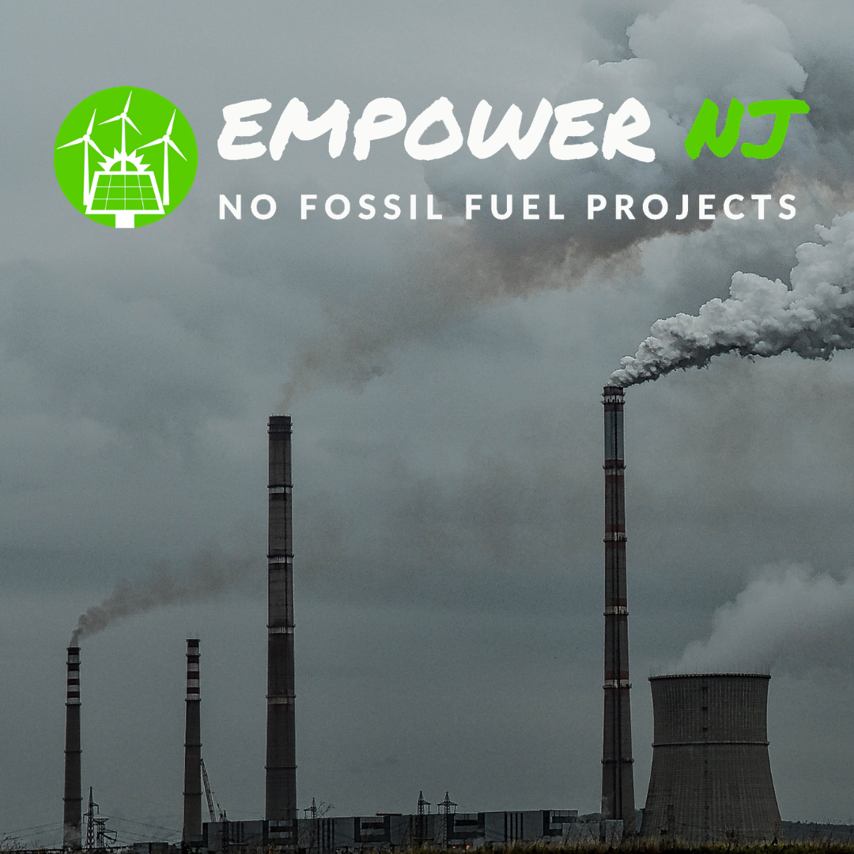
13 Fossil Fuel Projects
Pipeline and Compressor Stations
PennEast Pipeline
Northeast Supply Enhancement Pipeline
South Jersey Pipeline
Southern Reliability Link Pipeline
Garden State Expansion Project Compressor
Gateway Expansion Project Compressor
Rivervale South to Market Pipeline
Lambertville Expansion Compressor
Power Plants
Meadowlands
Phoenix Energy Center
BL England
Keasbey Energy Center
Sewaren 7 (went into service in mid 2018)

Slide 6
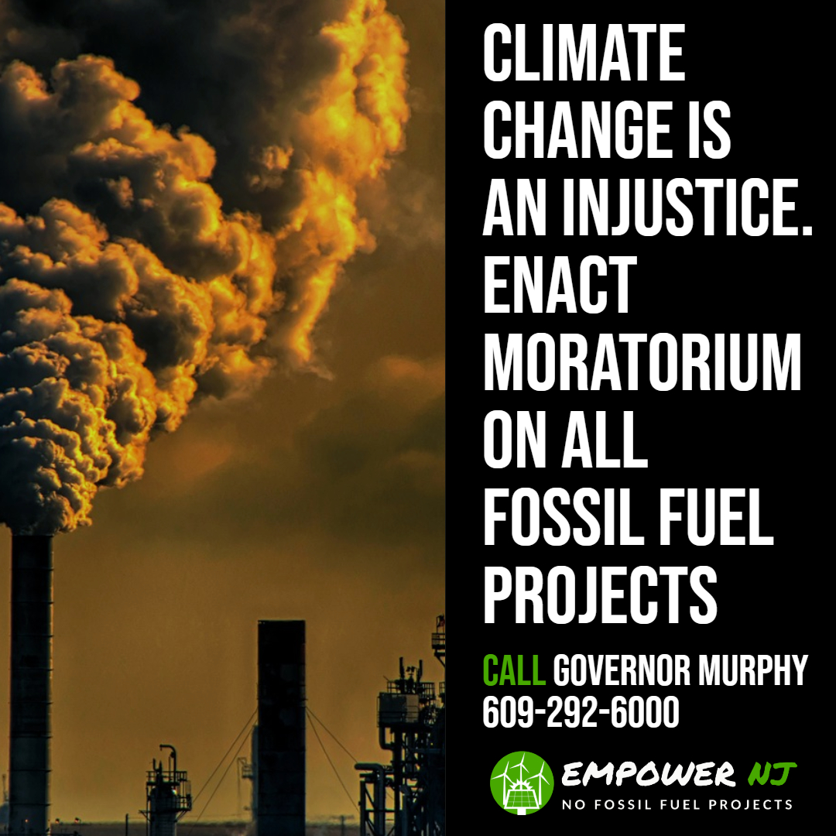
MORATORIUM
Immediate moratorium on all new fossil fuel projects
During moratorium the Administration, Legislature, DEP and BPU
Develop rules, procedures and laws to regulate and reduce GHGs
Governor Murphy and the Administration have the authority to act but have shown no interest in doing so
Utilize authority under Clean Air Act, GWRA and NJ Air Pollution Control Act (DEP declared CO2 an air pollutant in 2005)
Enable DEP to reject permits for projects that would cause NJ to exceed its GHG limits
Develop specific annual plans to meet GHG commitments
Administration looking at the legal issues

Slide 7
NJ Moratorium Precedent
NJ has a history of putting in place moratoriums in order to deal with an environment problem until it issue is resolved.
Governor Byrne put a stop on all development in the Pinelands until the Pinelands Act was passed.
Governor Kean put a moratorium on filling in freshwater wetlands to protect us from flooding until a wetlands protection law was passed. Kean also put a moratorium on development projects until sewer plants were upgraded to protect clean water.
Governor Florio put a moratorium on all new incinerators and stopped them under construction to protect our air quality from toxic emissions.
It’s time Governor Murphy follows his predecessors and puts in place a moratorium.

Slide 8
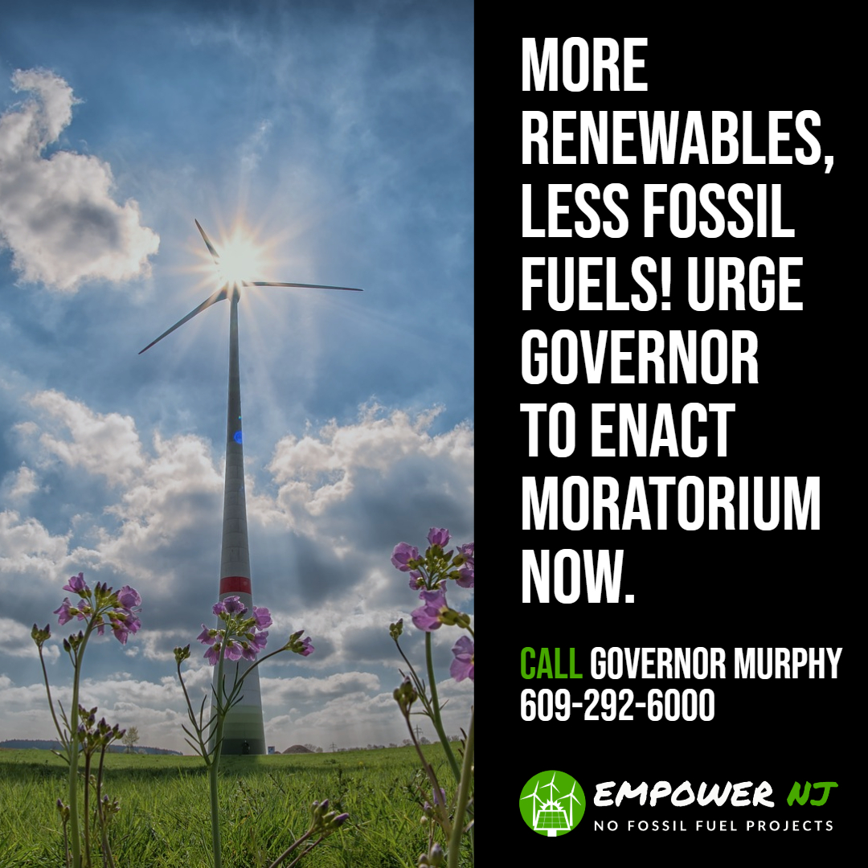
Other Actions During Moratorium
Revise DEP policies on ozone credits
This one action would likely stop all new power plants
Update DEP rules on air deposition
Require realistic renewable energy alternatives
Remove cost cap on renewable energy
Reverse Christie rollbacks of water regulations
Appoint new members to Pinelands Commission and Highlands Council to protect resources
Create strong green jobs program

Slide 9
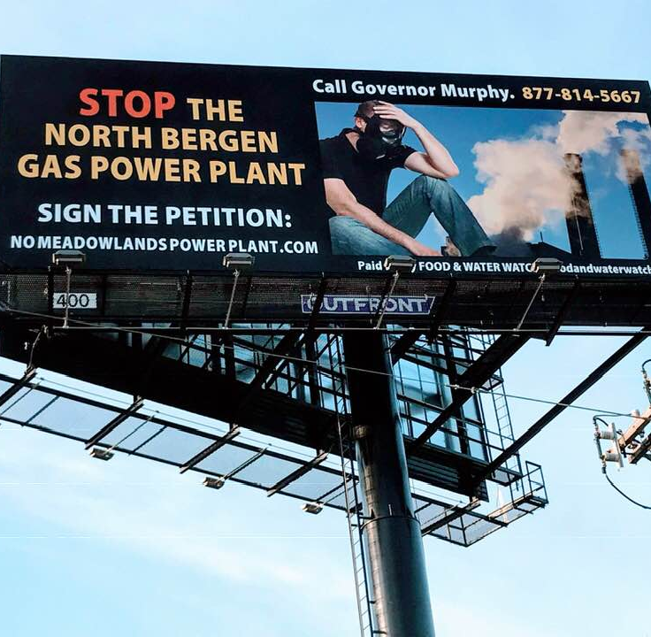
GHG Impact from New Projects
Baseline emissions:
NJ total GHG emissions – 100MMt/yr
NJ power plant GHG emissions – 18.6MMt/yr
13 projects net new emissions:
32MMt/yr* total - an increase of 32% in total GHG emissions
14.2MMt/yr - power plant consumption (included in above number) – an increase of 76% in total power plant GHG emissions
43.3MMt/yr – full methane lifecycle (NJ and PA)
“If you find yourself in a hole, stop digging.” Will Rogers
*Million Metric tons per year

Slide 10
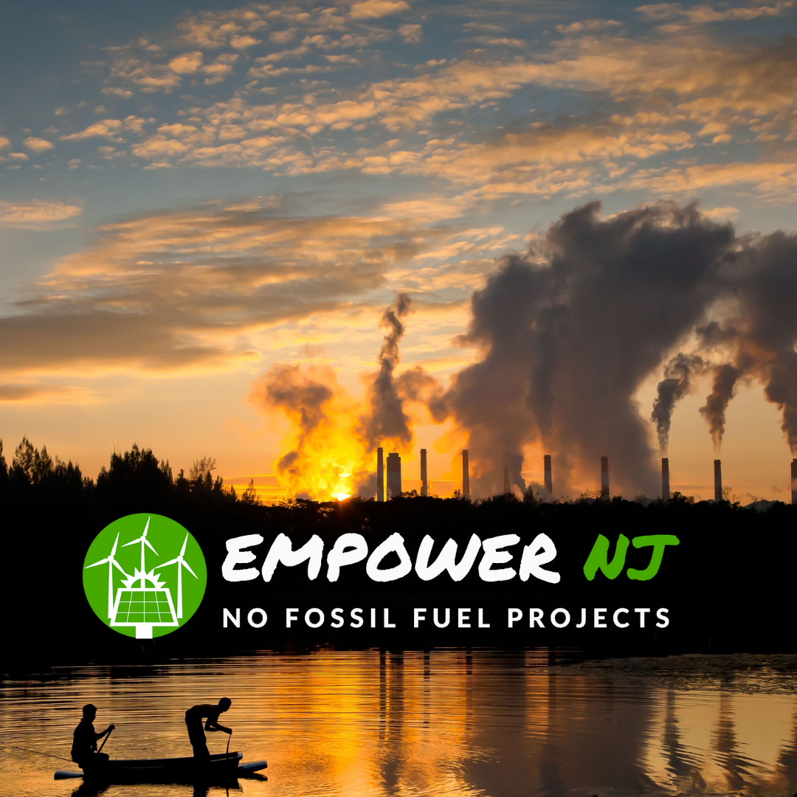
Strategic Importance of Stopping New Gas Projects
“Natural” gas consists mostly of methane
Leaks at all stages of life cycle
2.6% to 4.1 %of total volume from extraction to consumption (fracked gas)
86 times more potent as GHG than CO2 in 20 yr. timeframe
Fracked gas is worse for climate change than burning coal
67% of all gas in 2015

Slide 11
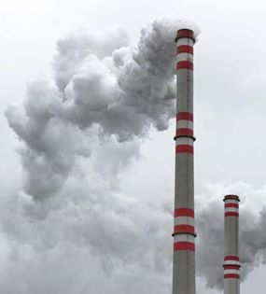
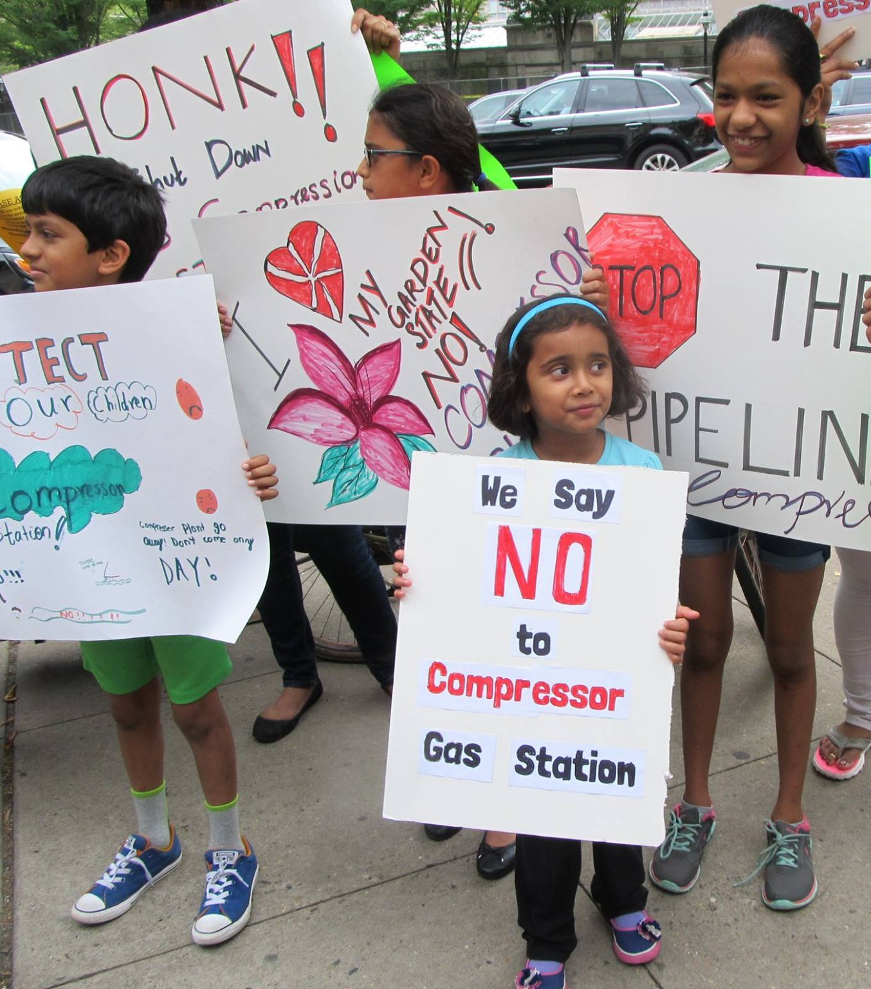
Health Impacts
Compressor stations and power plants emit many Hazardous Air Pollutants (HAPs) and ozone precursors. Environmental Justice communities are particularly susceptible.
HAPs include:
carcinogens, NOx, SOx, particulate matter, CO2, CO, VOCs
Health impacts include :
neurological, cardiovascular and respiratory disease (asthma, COPD), cancer, birth defects, premature death and many other diseases such as dementia and stroke
Statistics linking ozone, in particular, to premature death are well known.
A 10 ppb rise in smog increases daily mortality rate by 0.5%.
Gas projects have lifetimes of 30 to 40 years during which time and beyond, impacted residents will have increased hospital stays, loss of work time, increased health care costs and increased rates of premature death.
Allowing unnecessary power plants is morally unconscionable

Slide 12
Green Energy Jobs
Clean electricity jobs outstrip fossil fuel five to one
Energy efficiency, solar, wind, alternative vehicles
Transition to 100% renewable in NJ for all needs would create over 134,000 jobs
Nationwide reduction of GHGs by 80% by 2050 would produce more than 550,000 jobs each year
Given union focus on new fossil fuel jobs the Administration must create a strong green jobs program including training, placement and guaranteed transition for fossil fuel workers.
Green job growth will exceed that of fossil fuels
Instead of union opposition to cutting fossil fuel jobs imagine union demands for more green jobs

Slide 13
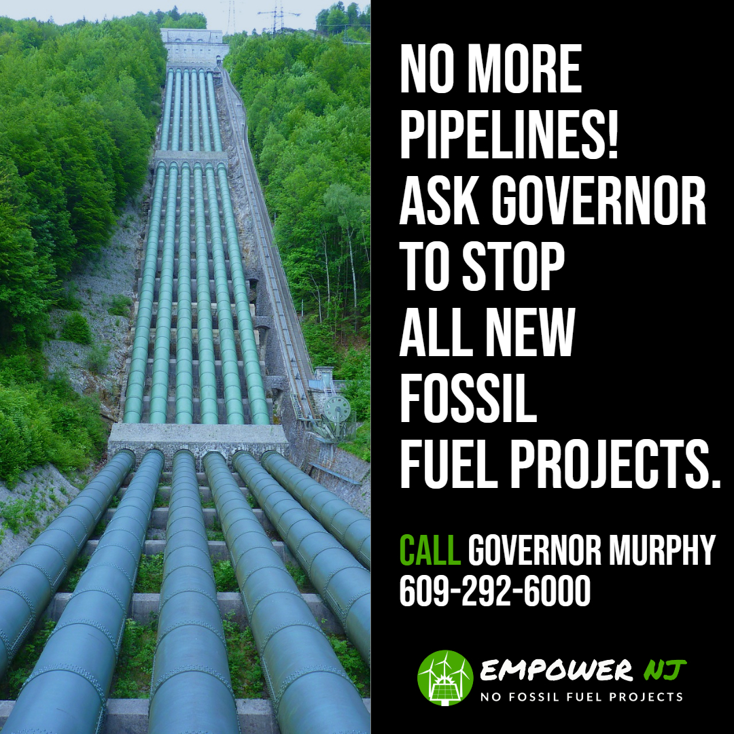
What Can I Do?
Contact Governor Murphy at:
Email:constituent.relations@nj.gov Phone: 609-292-6000
Contact your state legislators
Sign our petitions at:
www.empowernewjersey.com

Slide 14
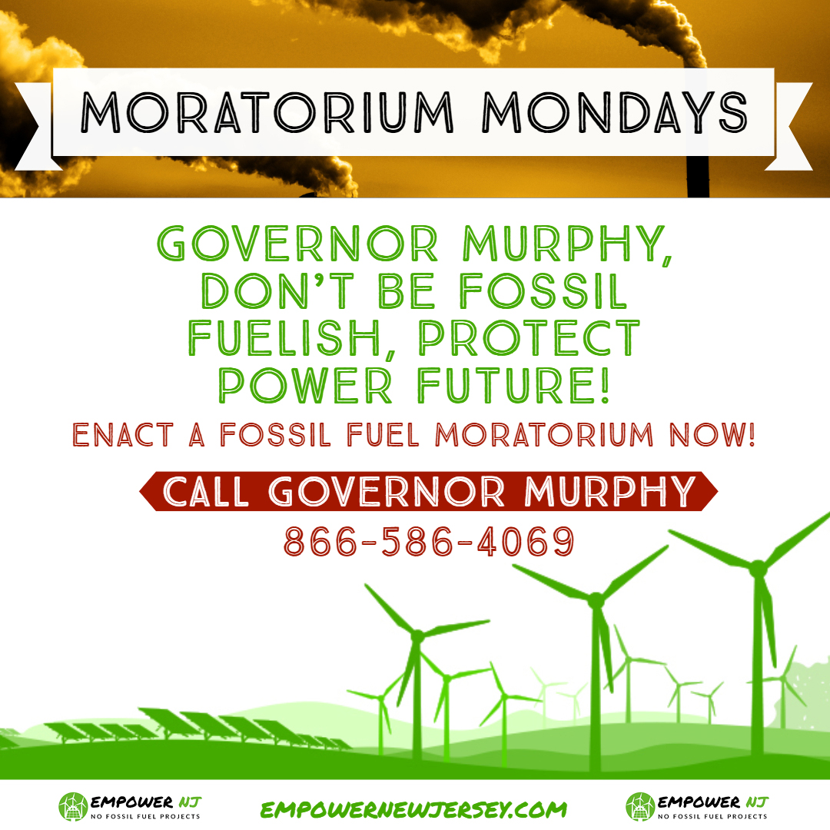
Get Social!
Social Media: Moratorium Mondays!
Every Monday we call Governor Murphy!
Facebook: https://www.facebook.com/events/2118615954892331/
#MoratoriumMondays

Slide 15
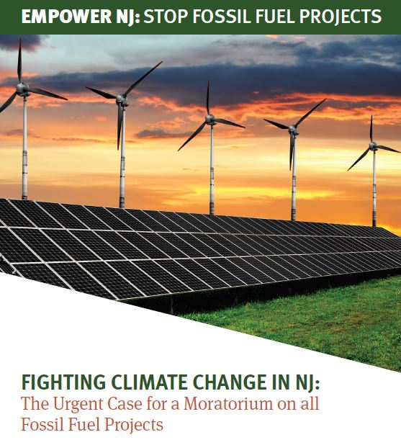
Resources
Empower NJ Website:
www.empowernewjersey.com
Read our new report
and share it widely!
Watch the website and Facebook Page for Forums and upcoming events: https://www.facebook.com/events/278062159579793/

