Slide 1
FIGHTING Climate Change in NJ:
The Urgent Case for a Moratorium
on all Fossil Fuel Projects

Slide 2
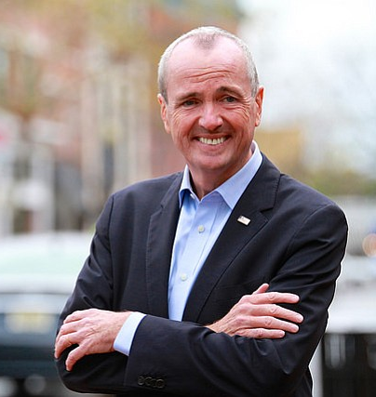
“The verdict is in. The world must act now to curb the cataclysmic effects of climate change. In NJ, we set a path to 100% clean energy by 2050, signed sweeping clean energy legislation and are protecting our land & water. Our children deserve nothing less.” Governor Murphy, 11/24/18

Slide 3
Climate Change is Accelerating
November 2018 National Climate Assessment
Hundreds of billions in annual damage
10% of U.S. GDP at risk
IPPC 2018 Report
Many effects expected decades in the future will arrive by 2040 without 45% GHG reduction
NJ is ground zero
NJ (and Florida) have over 1/3 of commercial coast properties at risk
Higher percentages of citizens recognize that climate change is real
Over 85% of Democrats
Over 56% of Republicans
THE TIME FOR ACTION IS NOW!

Slide 4
Administration Actions to Date
Joined US Climate Alliance
Committed to reduce GHGs by 26% to 28% below 2005 levels by 2025
EO 28 requires 50% of electric production from clean renewable energy by 2030, 100% by 2050
Electric production only produces 19% of NJ GHG. Cutting this to zero will not come close to a 45% reduction
Achieving 100% renewable in 2049 will be too late
EO 8 supports 3,500 MW of offshore wind energy by 2030
Opposed offshore drilling
Filed petition against FERC on PennEast pipeline
All target dates are after Governor Murphy leaves office

Slide 5
Administration Inaction to Date
GHG emissions remain unregulated despite authority under:
Clean Air Act (Title V)
NJ Air Pollution Control Act
NJ Global Warming Response Act
No rules to achieve EO 28 goals
No new appointees to Pinelands and Highlands regulatory bodies
Offices of Climate Change and Climate Adaption & Mitigation remain closed
Many changes only require the Governor’s action

Slide 6
13 Fossil Fuel Projects
Pipeline and Compressor Stations
PennEast Pipeline
Northeast Supply Enhancement Pipeline
South Jersey Pipeline
Southern Reliability Link Pipeline
Garden State Expansion Project Compressor
Gateway Expansion Project Compressor
Rivervale South to Market Pipeline
Lambertville Expansion Compressor
Power Plants
Meadowlands
Phoenix Energy Center
BL England
Keasbey Energy Center
Sewaren 7 (went into service in mid 2018)

Slide 7
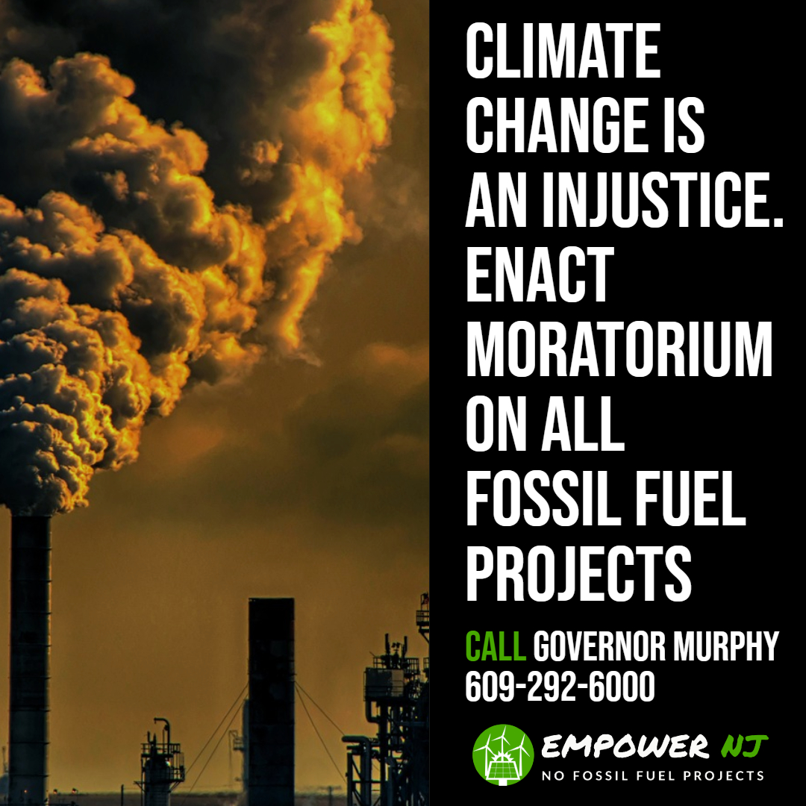
MORATORIUM
Immediate moratorium on all new fossil fuel projects
During moratorium the Administration, Legislature, DEP and BPU
Develop rules, procedures and laws to regulate and reduce GHGs
Governor Murphy and the Administration have the authority to act but have shown no interest in doing so
Utilize authority under Clean Air Act, GWRA and NJ Air Pollution Control Act (DEP declared CO2 an air pollutant in 2005)
Enable DEP to reject permits for projects that would cause NJ to exceed its GHG limits
Develop specific annual plans to meet GHG commitments
The Administration is looking at the legal issues

Slide 8
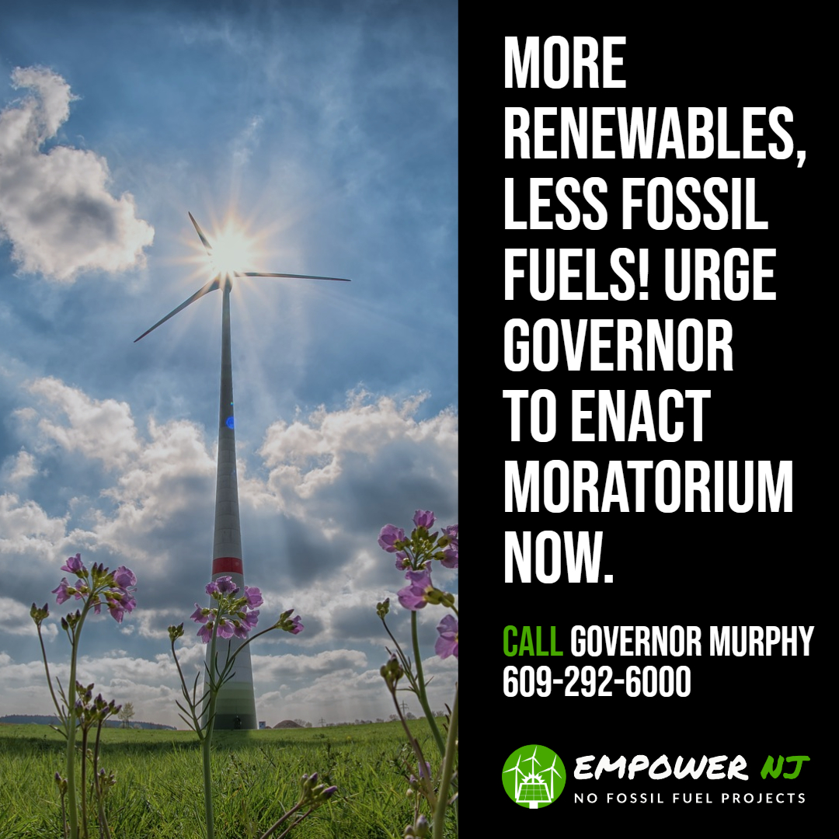
Other Actions During Moratorium
Revise DEP policies on ozone credits
This one action would likely stop all new power plants
Update DEP rules on air deposition
Require realistic renewable energy alternatives
Remove cost cap on renewable energy projects
Reverse Christie’ rollbacks of water regulations
Appoint new members to Pinelands Commission and Highlands Council to protect resources
Create strong green jobs program

Slide 9
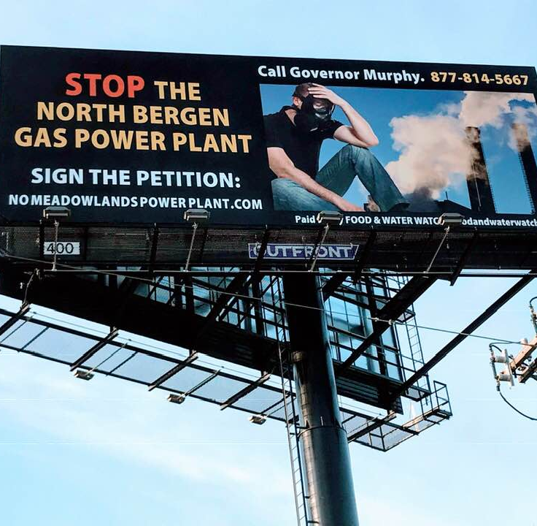
GHG Impact from New Projects
Baseline emissions:
NJ total GHG emissions – 100MMt/yr
NJ power plant GHG emissions – 18.6MMt/yr
13 projects net new emissions:
32MMt/yr* total - an increase of 32% in total GHG emissions
14.2MMt/yr - power plant consumption (included in above number) – an increase of 76% in total power plant GHG emissions
43.3MMt/yr – full methane lifecycle (NJ and PA)
“If you find yourself in a hole, stop digging.” Will Rogers
*Million Metric tons per year

Slide 10
Strategic Importance of Stopping New Gas Projects
“Natural” gas consists mostly of methane
Leaks at all stages of its life cycle
2.6% of total volume from extraction to consumption (fracked gas)
86 times more potent as GHG than CO2
Fracked gas is worse for climate change than burning coal
67% of all gas in 2015

Slide 11
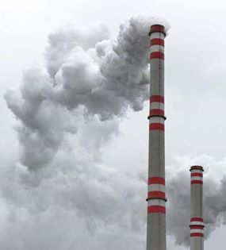
Health Impacts
Compressor stations and power plants emit many Hazardous Air Pollutants (HAPs) and ozone precursors
HAPs include carcinogens, NOx, SOx, particulate matter, CO2, CO, VOCs
Health impacts include neurological, cardiovascular and respiratory disease (asthma, COPD), cancer, birth defects, premature death and many other diseases such as dementia and stroke
Allowing unnecessary power plants is morally unconscionable

Slide 12
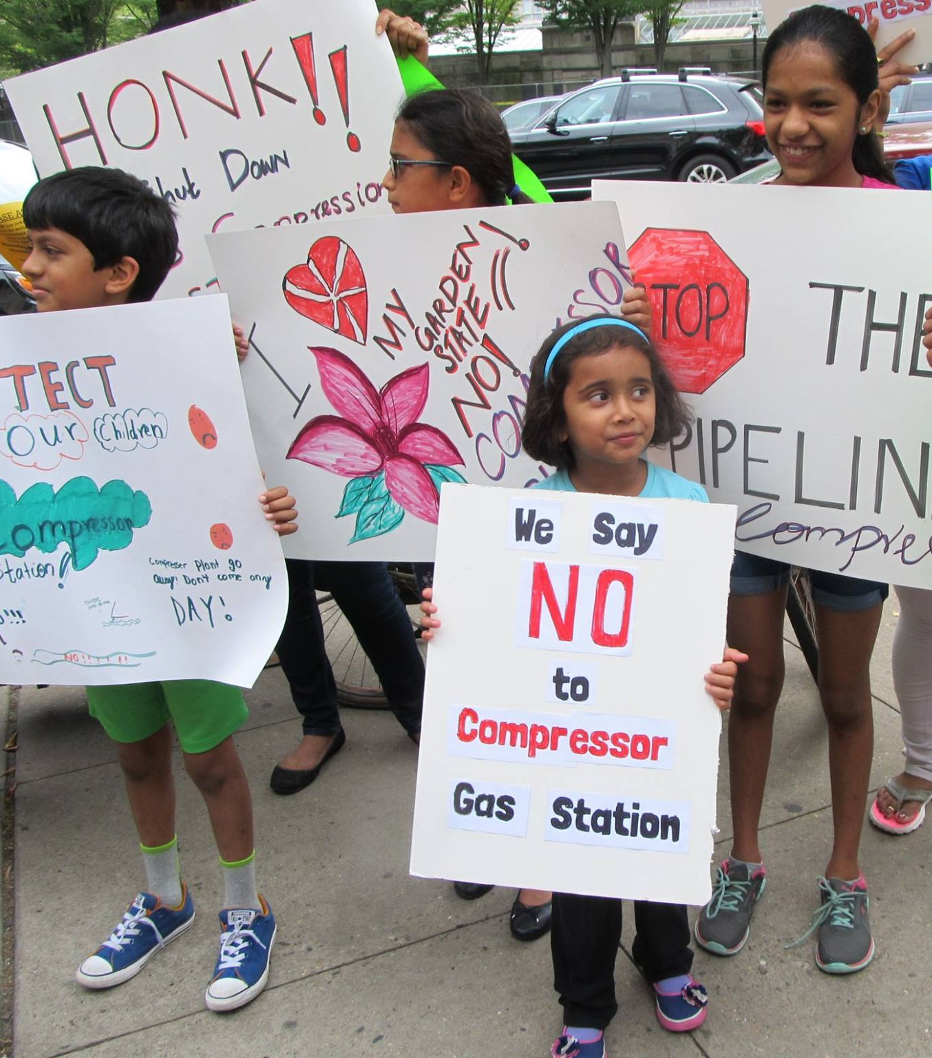
Health Impacts
The statistics linking ozone, in particular, to premature death are well known
A 10 ppb rise in smog increases daily mortality rate by 0.5%.
Gas projects have lifetimes of 30 to 40 years during which time and beyond, impacted residents will have increased hospital stays, loss of work time, increased health care costs and increased rates of premature death.
Environmental Justice communities are particularly susceptible.
Allowing unnecessary power plants is morally unconscionable

Slide 13
Green Energy Jobs
Clean electricity jobs outstrip fossil fuel five to one
Energy efficiency, solar, wind, alternative vehicles
Transition to 100% renewable in NJ for all needs would create over 134,000 jobs
Nationwide reduction of GHGs by 80% by 2050 would produce more than 550,000 jobs each year
Given union focus on new fossil fuel jobs the Administration must create a strong green jobs program including training, placement and guaranteed transition for fossil fuel workers.
Green job growth will exceed that of fossil fuels
Instead of union opposition to cutting fossil fuel jobs imagine union demands for more green jobs

Slide 14
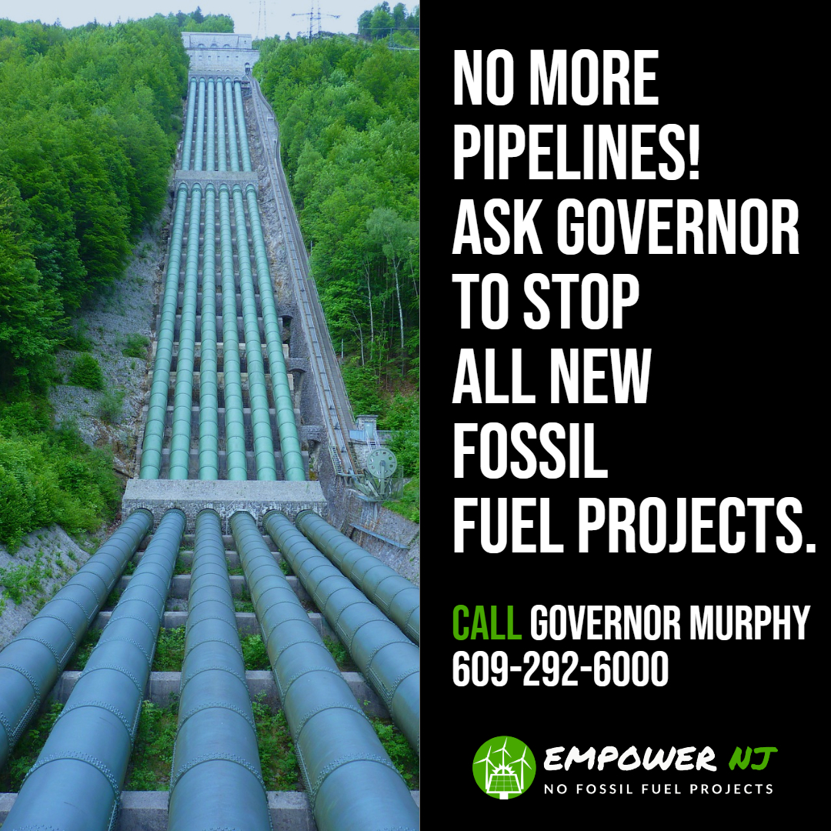
What Can I Do?
Contact Governor Murphy at:
Email:constituent.relations@nj.gov Phone: 609-292-6000
Contact your state representatives and county freeholders
Sign our petitions at:
www.empowernewjersey.com and www.nomeadowlandspowerplant.com

Slide 15
Get Social!
Post on Social Media: Tweet: @GovMurphy More renewables, less fossil fuels! please enact moratorium on fossil fuel projects to ensure we meet NJ’s renewable energy goals. #Empower NJ
Facebook: Tag @GovernorPhilMurphy in your posts

Slide 16
Resources
Empower NJ Website:
www.empowernewjersey.com
Read our new report and share it widely!

